Slide 1
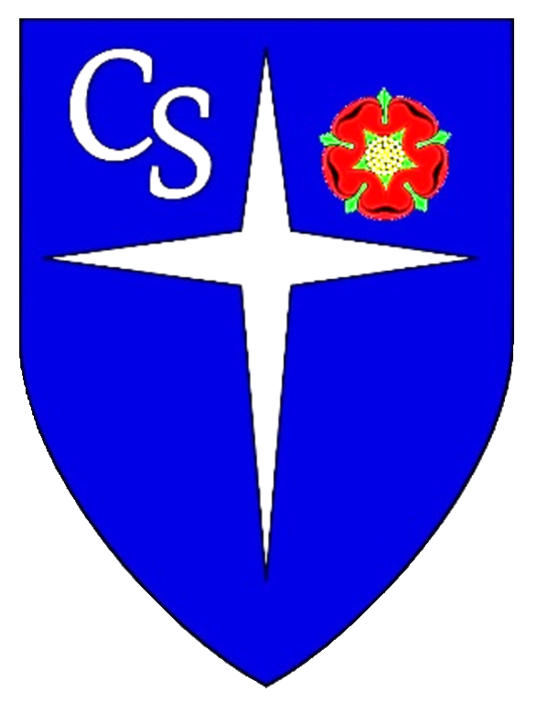
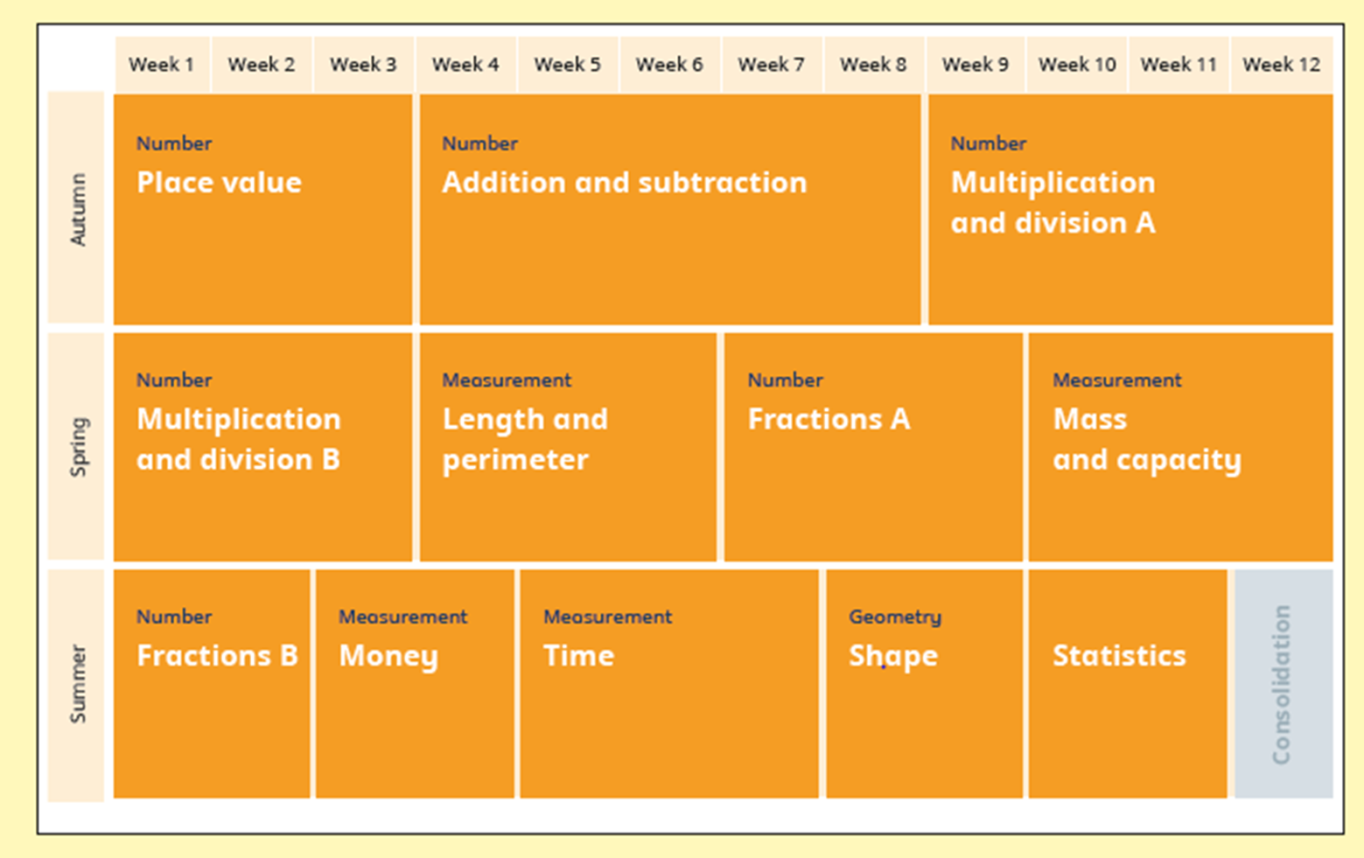
Year 3 – Yearly Overview 2022/23
https://www.ncetm.org.uk/classroom-resources/cp-curriculum-prioritisation-in-primary-maths/
https://whiterosemaths.com/resources/primary-resources/primary-sols/
https://www.ncetm.org.uk/resources/50639

